Slide 1
Volumetric Capture
Marcel Bruckner, Kevin Bein, Moiz Sajid

Slide 2
Goal
Frame Fusion

Slide 3
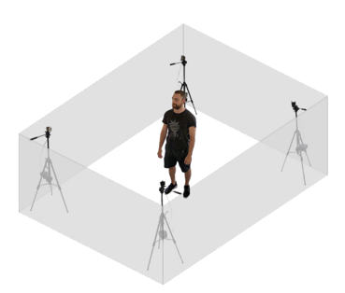
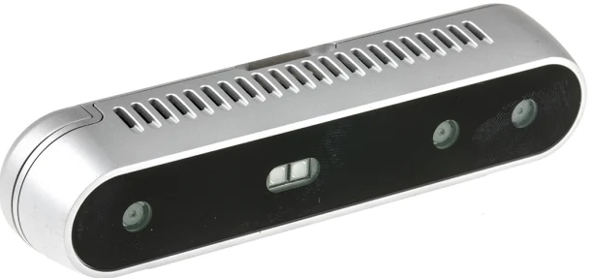
Setup
4x Intel RealSense Depth Camera D415
4x Tripods
USB Hub
USB Active Repeater Cables

Slide 4
Setup Problems
4x cameras are not working with single USB-Hub
Multiple Repeater Cables not working
Therefore, 3x cameras only

Slide 5
Pipeline Overview
RGB and depth frame capture
Post-Processing
Align RGB and depth frame
ChArUco Board detection
Callibration via Procrustes, Bundle Adjustment and ICP
Fusion into Voxelgrid
Compute Marching Cubes

Slide 6
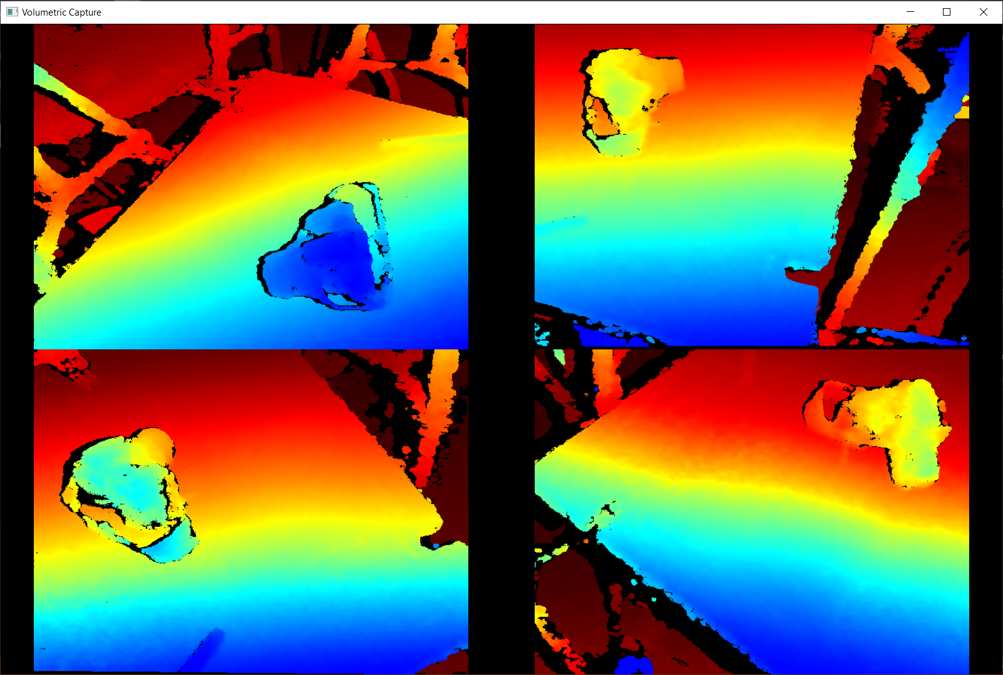
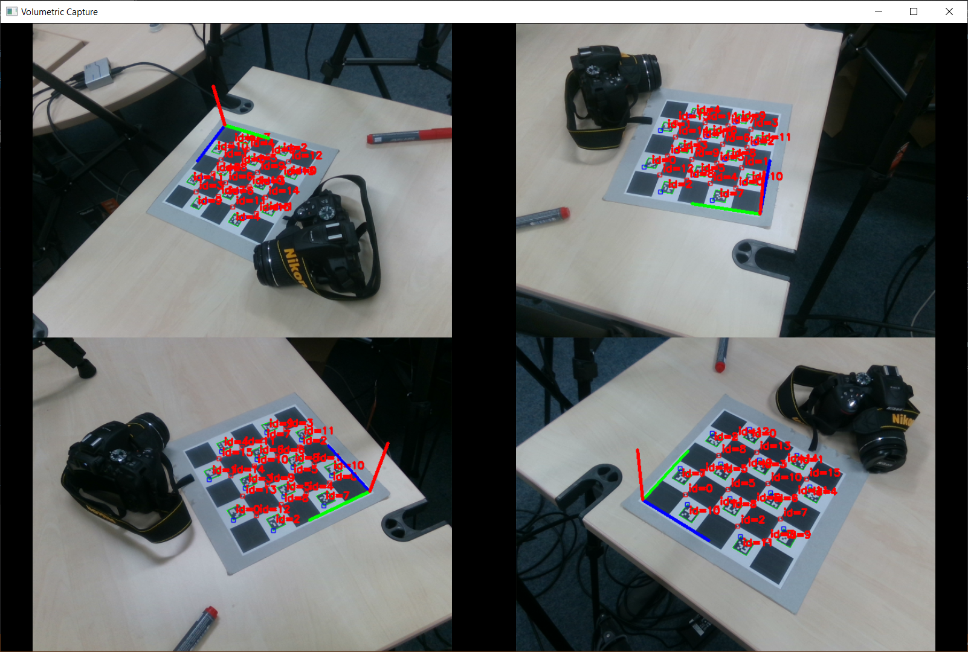
1. RGB and depth frame capture
1280x720 active stereo depth
1920x1080 RGB resolution

Slide 7
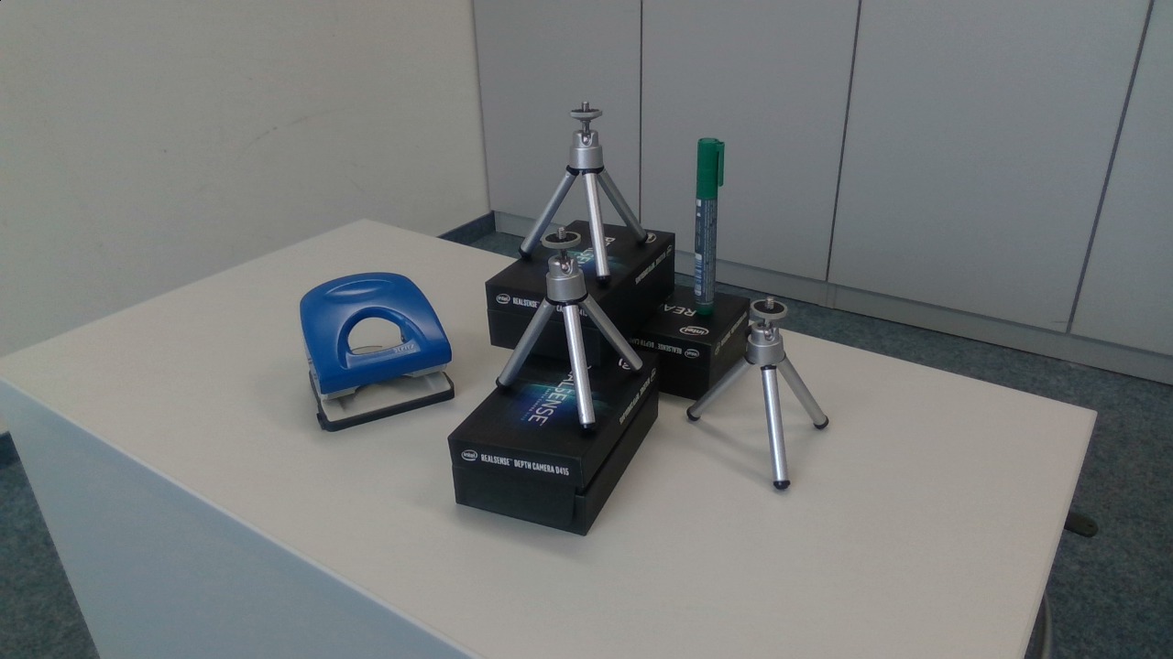
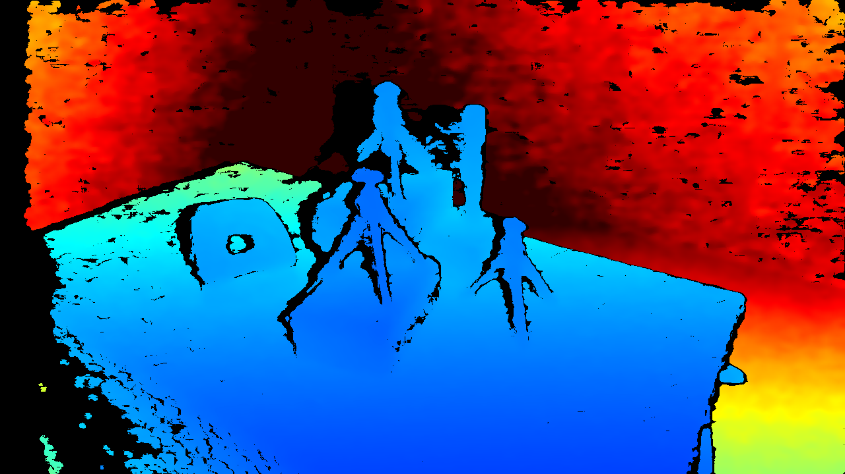
1. RGB and depth frame capture
1920x1080 RGB resolution
1280x720 active stereo depth

Slide 8
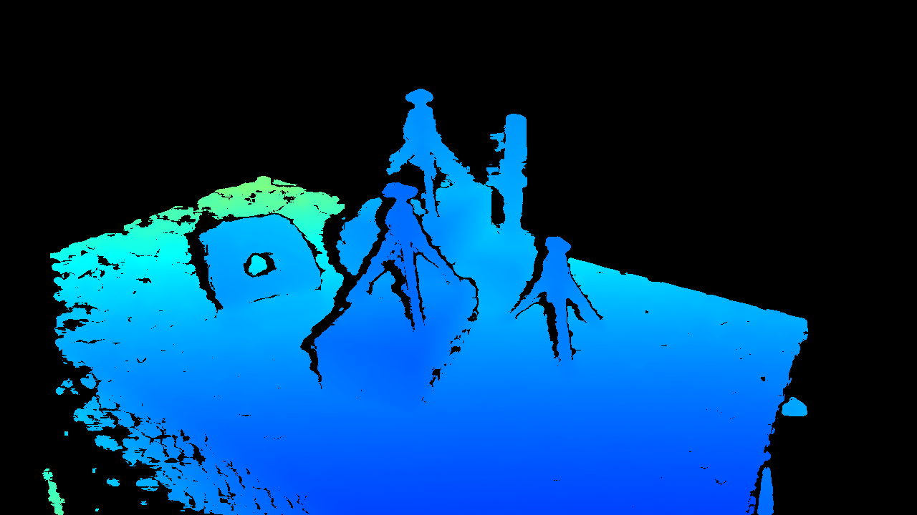
2. Post-Processing
2.1 Raw Input
2.2 Threshold Filter
Camera
librealsense

Slide 9
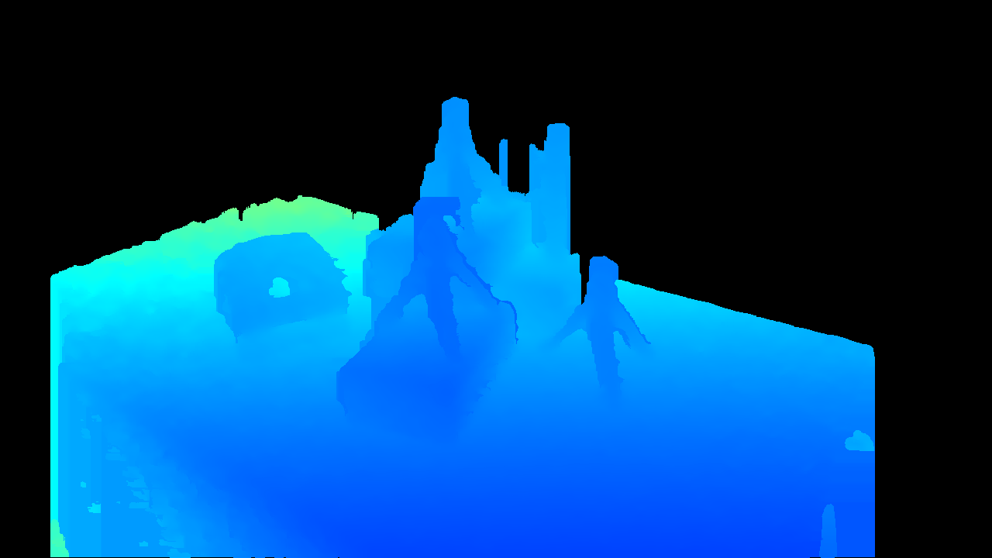
2. Post-Processing
2.1 Raw Input
2.2 Threshold Filter
2.3 Hole-Filling Filter
Camera
librealsense
librealsense

Slide 10
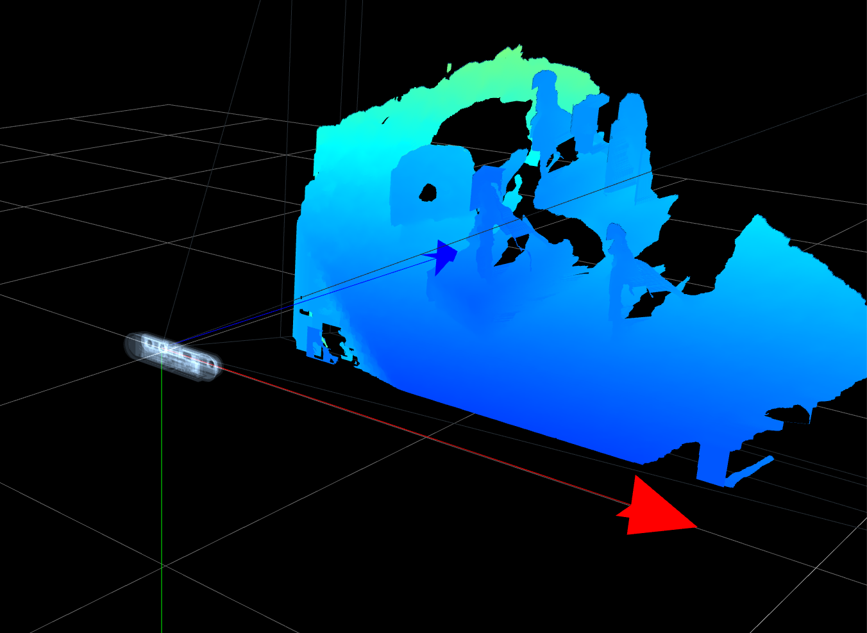
3. Align RGB and depth frame
librealsense

Slide 11
4. ArUco markers
Encodes messages (in our case: 1, 2, 3, 4, ...)
Can be easily detected
Position of edges are known

Slide 12
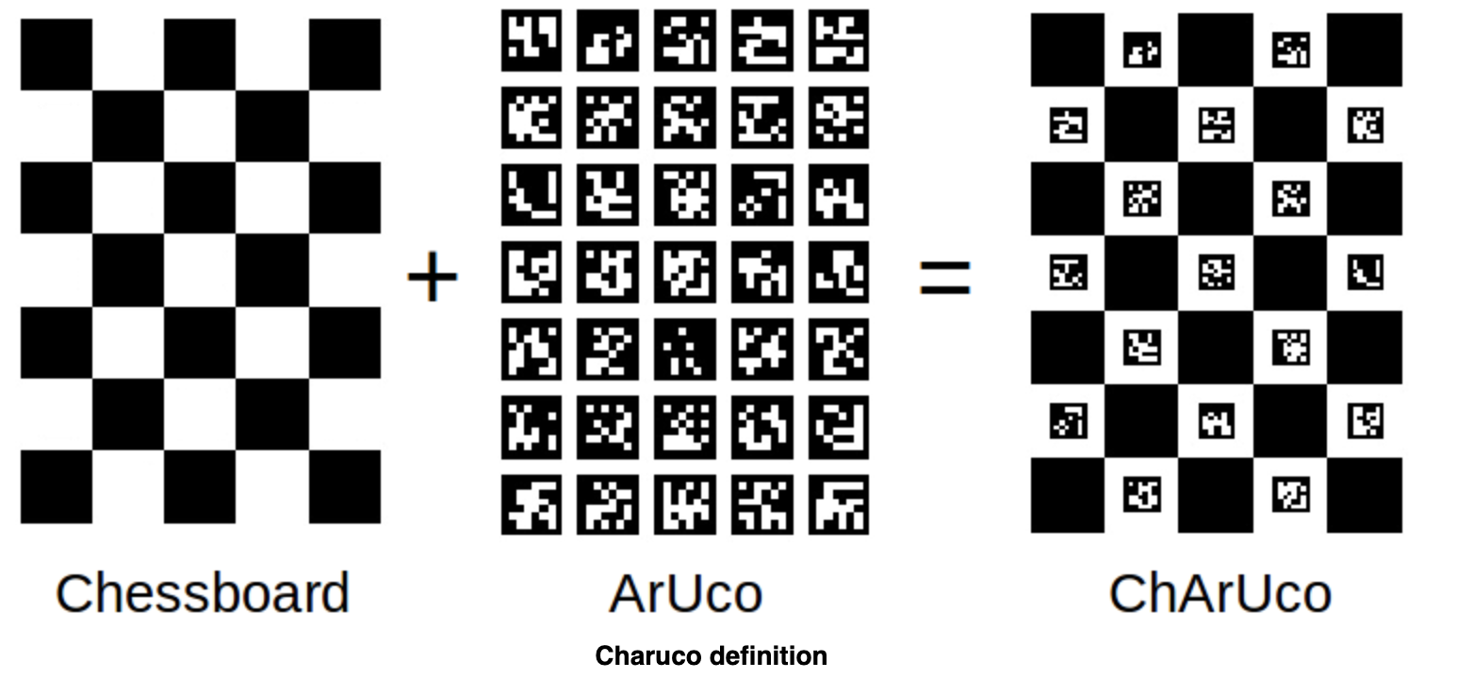
4. ChArUco
Combination of multiple ArUco markeres on a chessboard = ChArUco

Slide 13
4. ChArUco board detection
Detect 12 ChArUco corners in all camera streams

Slide 14
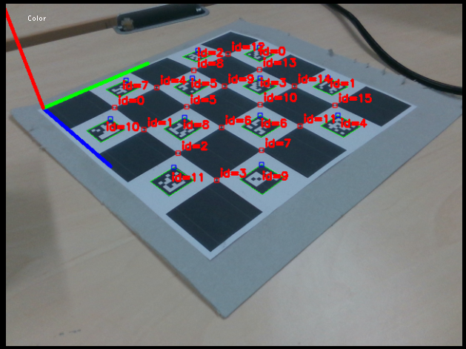
4. ChArUco board detection
Detect 16 ArUco markers on one board
Single board
All camera streams

Slide 15
4. ChArUco board detection
Detect 16 ArUco markers on one board
Low resolutions only
Noisy depth maps did not work too well during calibration

Slide 16
4. ArUco cube detection
Ultimately, big cube with single ArUco marker on each side
[big cube picture here]

Slide 17
5. Calibration via Procrustes and Bundle Adjustment
OpenCV:
cv::aruco::detectMarkers
cv::aruco::estimatePoseCharucoBoard
Returns: Rotation and translation matrix
Use detected ArUco corners as correspondences to refine rotation and translation matrices

Slide 18
5. Calibration via Procrustes and Bundle Adjustment
Use detected ArUco corners as correspondences to refine rotation and translation matrices
Initialize algorithm with Procrustes
Minimize re-projection error (Bundle adjustment)

Slide 19
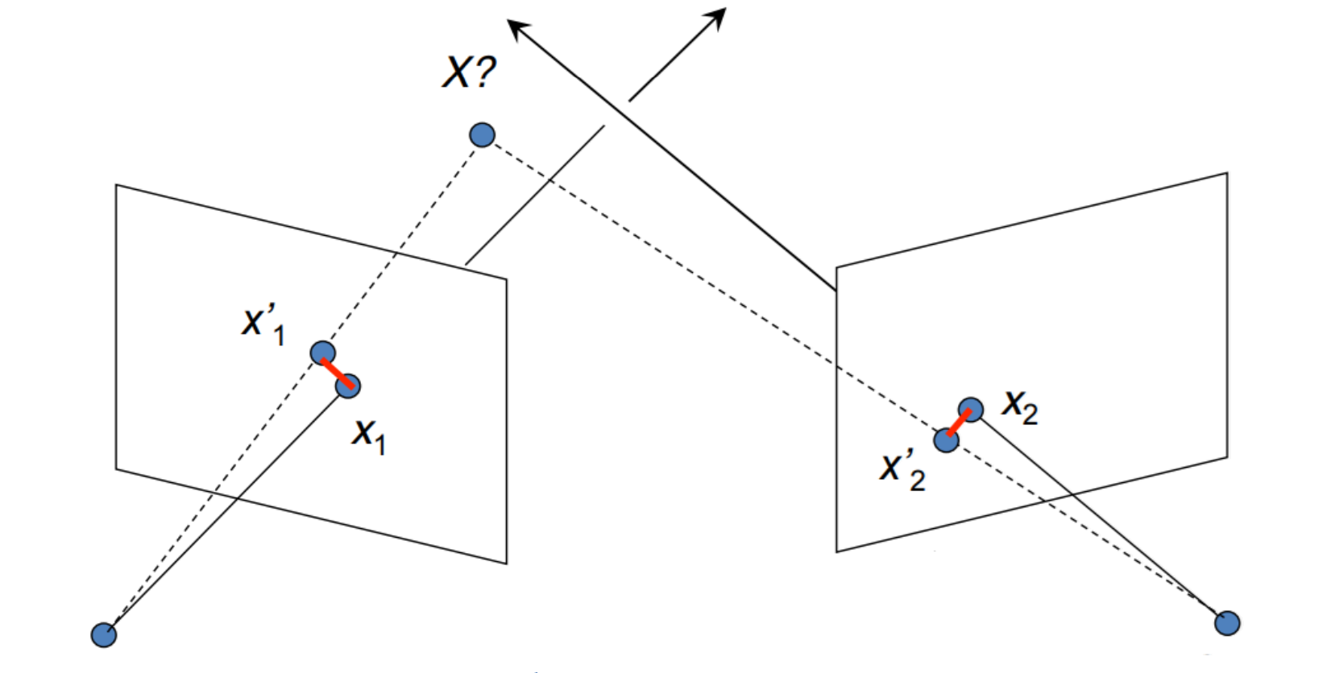
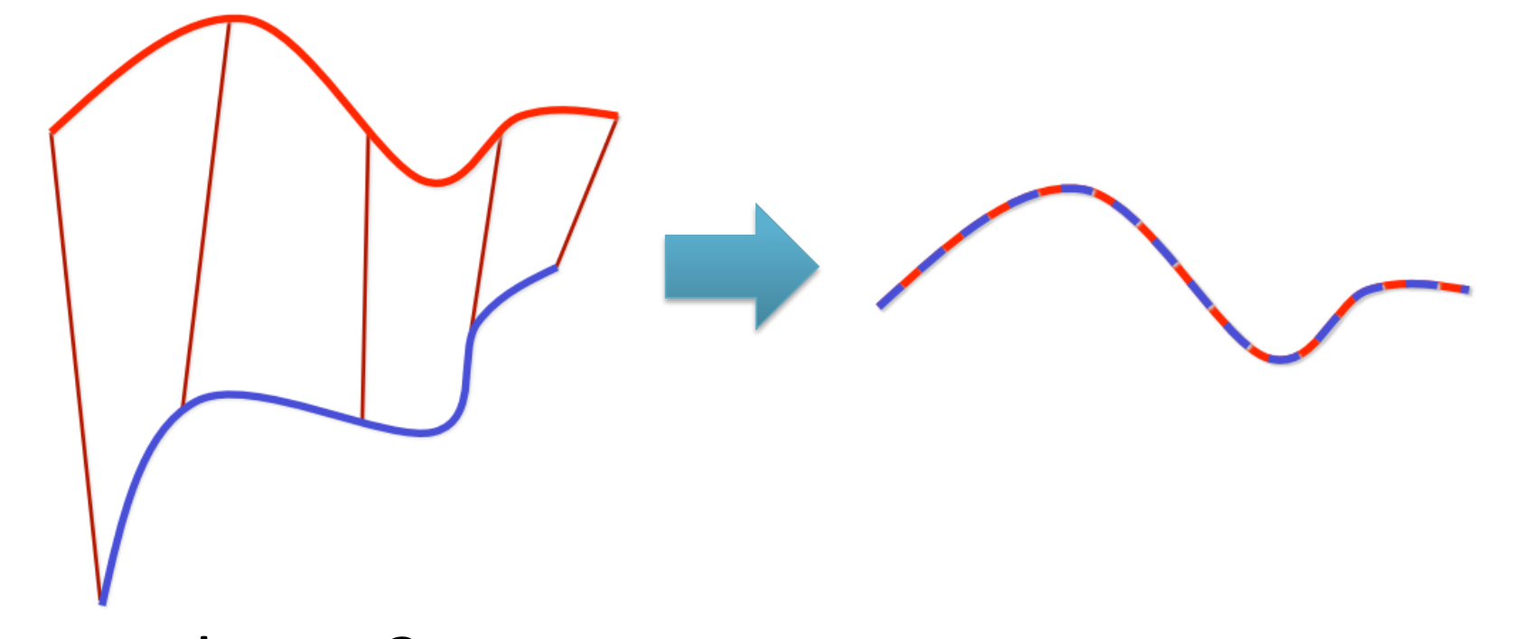
5. Calibration via Procrustes and Bundle Adjustment
Initialize algorithm with Procrustes
ArUco correspondences
Minimize rotation and translation

Slide 20
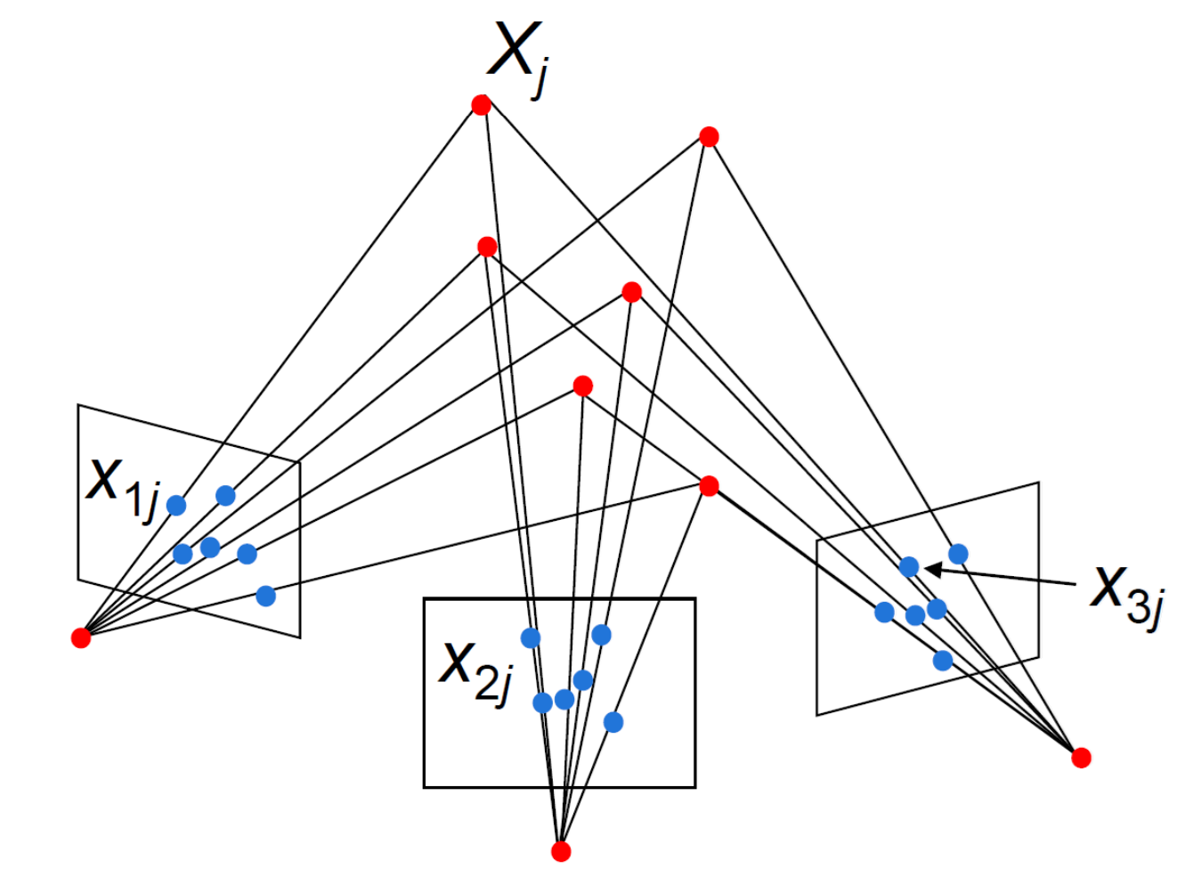
5. Calibration via Procrustes and Bundle Adjustment
Minimize re-projection error (bundle adjustment)

Slide 21
5. Calibration via Procrustes, Bundle Adjustment and ICP
Run ICP for further refinement

Slide 22
6. Fusion into Voxelgrid
Calculate TSDF values
Fuse aligned points into Voxelgrid

Slide 23
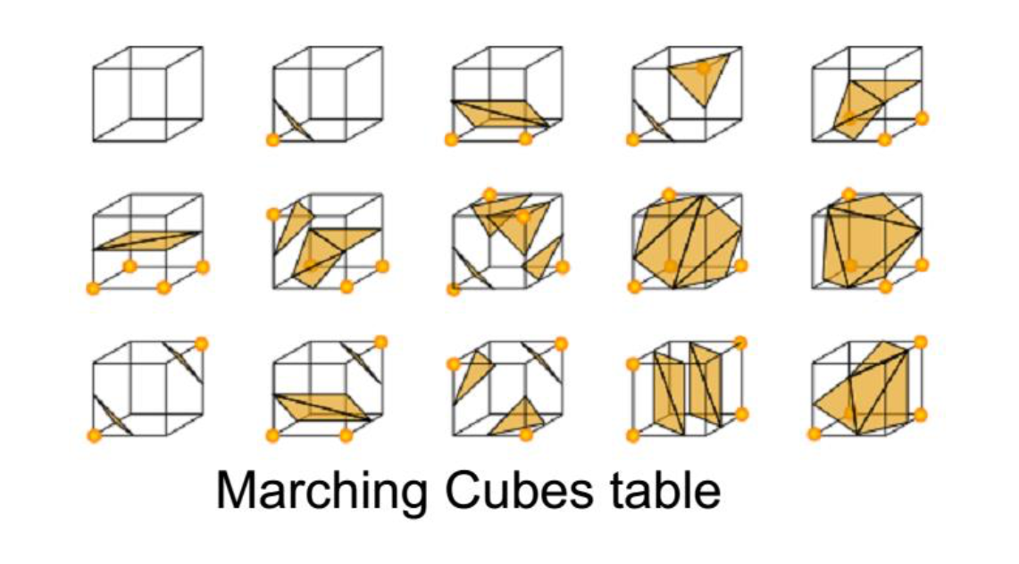
7. Compute Marching Cubes

Slide 24
7. Compute Marching Cubes

Slide 25
Future work
ICP to further improve Calibration
Edge Enhancements and artifact reduction

Slide 26
Implementation Details
Librealsense API
Camera communication
Post-processing filters: Hole-filling, Depth threshold
RGB and Depth alignment
OpenCV for ChArUco corner detection
OpenGL Rendering
OpenGL Shading Language
Immediate Mode GUI (imgui) for UX

Slide 27
Implementation Details
Custom implementation of Procrustes, Bundle Adjustment and ICP using Ceres solver and Eigen
Custom implementation of Marching Cubes
Not used:
Point Cloud Library (PCL)
CUDA
DirectX

Slide 28
Implementation Details
Custom implementation of Procrustes, Bundle Adjustment and ICP using Ceres solver and Eigen
Custom implementation of Marching Cubes
Not used:
Point Cloud Library (PCL)
CUDA
DirectX

Slide 29
Live Demo
Please feel free to join us in our office for a Live Demonstration!

Slide 30
Volumetric Capture
Thank you! Questions?

Slide 31
Pipeline Overview
RGB and depth frame capture
Post-Processing
Align RGB and depth frame
ChArUco Board detection
Callibration via Procrustes, Bundle Adjustment and ICP
Fusion into Voxelgrid
Compute Marching Cubes

